Slide 1
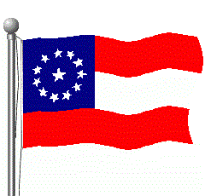
Civil War Study Guide

Slide 2
SECESSION
SOUTH CAROLINA IS FIRST TO LEAVE THE UNION ON DECEMBER 20, 1860, FOLLOWED BY MS, FL, AL, GA, LA, AND TX.
FEBRUARY 4, 1861 – CONFEDERATE STATES OF AMERICA ARE FORMED
JEFFERSON DAVIS IS ELECTED ITS FIRST PRESIDENT
FIRST CAPITAL – MONTGOMERY, ALABAMA

Slide 3
Lincoln Takes Office
Seven states had already seceded and formed Confederate States of America
Lincoln told others that he would not abolish slavery
Confederacy began taking over all federal posts and forts
Fort Sumter – Charleston, SC
April 12, 1861
First shots of the Civil War
Lincoln calls for 75,000 state militia to put down the rebellion

Slide 4
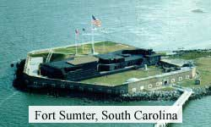
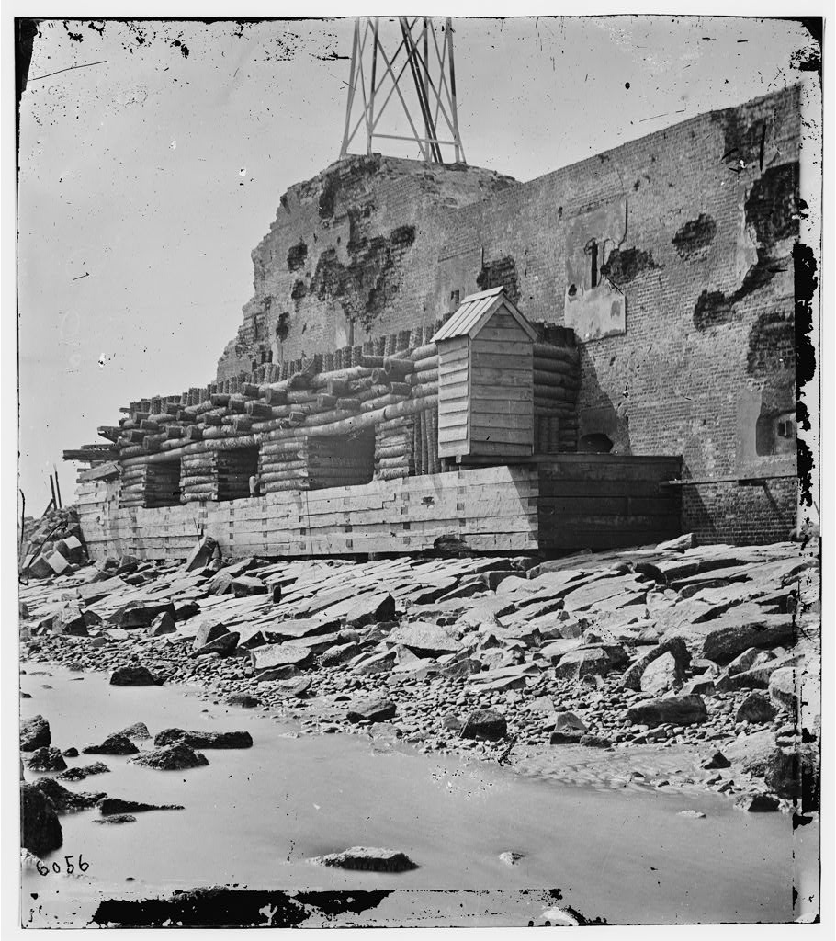
Fort Sumter After The Battle
Fort Sumter Today

Slide 5
Choosing Sides
Four more slave states join Confederacy – NC, VA, TN, ARK – Richmond, VA. becomes Confederate capital
Slave States that stay with the Union – MD, KY, MO, DE – border states – MD most important
People of Western Virginia refuse to leave the Union and break away, forming West Virginia into a state by 1863
Both sides rely on volunteers at the start, believing the war will be over quickly

Slide 6
Northern Advantages
North – Union or Federal - Blue
Bigger Population
22 million to 9.5 million (South) – 4 million slaves
Military-age men
North – 2.1 million
South – 800,000
Most of the industries, factories, and shipyards – more weapons and supplies
Most of the Railroads
23,000 miles to 9,000 miles
More efficient transportation
Much bigger financial resources
Central Government is stronger and in charge
“Battle Hymn of the Republic”

Slide 7
Southern Advantages
South – Confederate or Rebels - Gray
Better military leaders
Southern Lifestyle – southern men were used to being outdoors camping, hunting, riding etc. Made better soldiers at first
Only had to fight defensively – defense has the advantage
Fighting on their own ground
“Dixie”

Slide 8
First Plans
North
Anaconda Strategy
Blockade southern ports to cut off supplies and control Mississippi River to split South in half
Would not work quickly
Capture Richmond, VA – Confederate Capital
South
Defend itself and wear down North’s will to fight
Capture Washington, DC – Union Capital
Cotton Diplomacy – believed that England and France would help them to get Southern cotton

Slide 9
Civil War Weapons
Infantry – foot soldiers – occupy land
Cavalry – rode horses – scouting
Artillery – cannon – support attack and defend places
Battleline – double line of soldiers – one line firing, one line re-loading
Bayonet – stabbing blade attached to end of rifle when charging
Hollow Shot/Canister

Slide 10
Springfield – Main Union Rifle
Enfield – Main Confederate Rifle

Slide 11
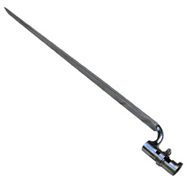
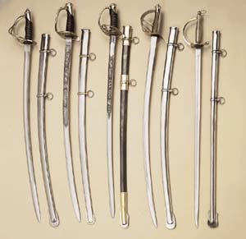
Officer and Cavalry Swords
Bayonet

Slide 12
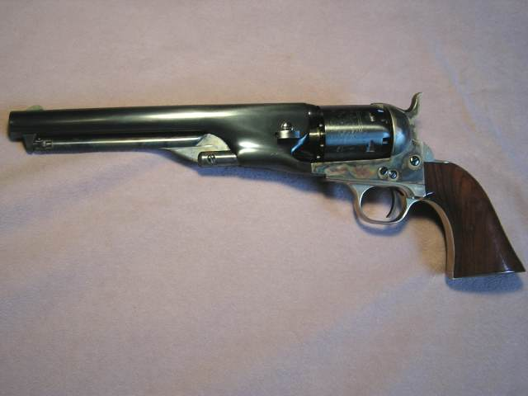
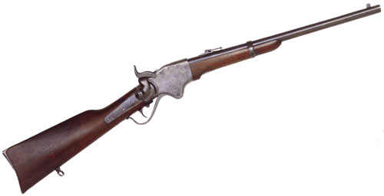
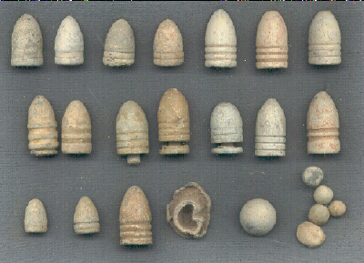
Sharps Rifles
Colt
Revolver
Spencer Rifle
Minie Bullets

Slide 13
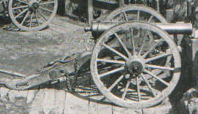
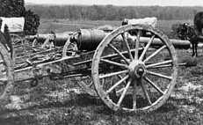
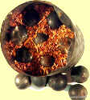
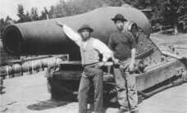
Napoleon
Parrott
Canister
Dahlgren

Slide 14
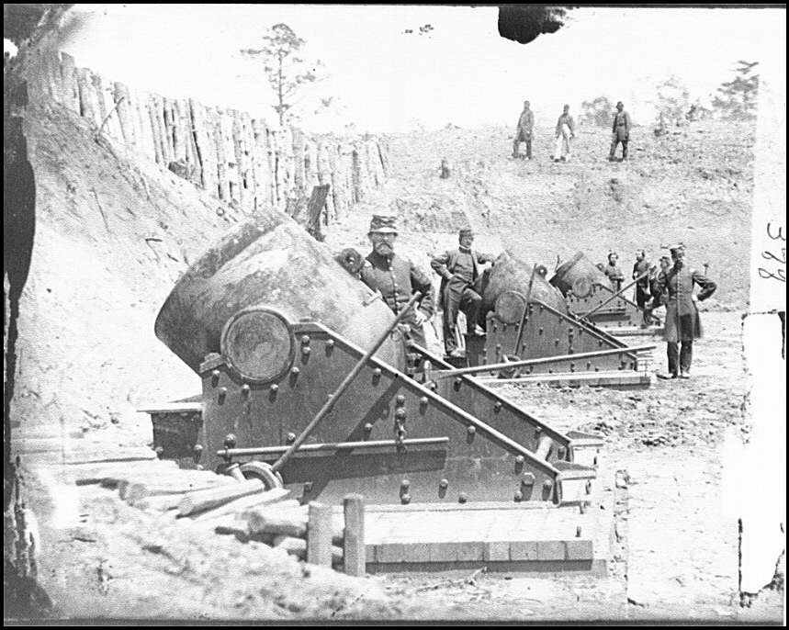
13 inch mortars

Slide 15
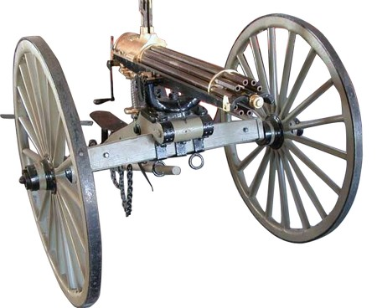
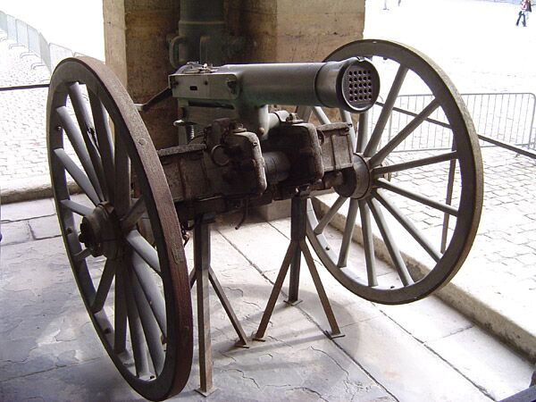

Slide 16
Civil War Battles
South – named battles after nearest town
North – named battles after nearest land feature – town, river, mountain etc.

Slide 17
First Battles in the East 1861-62
Most Major fighting was done in Northern Virginia area between the capitals.
July 21, 1861 – First Manassas (Bull Run) – Confederate Victory – Stonewall Jackson
Both sides prepare for a longer war
Main Armies
North – Army of the Potomac – George McClellan becomes new commander in July 1861
South – Army of Northern Virginia – Robert E. Lee becomes commander in June 18, 1862
South wins most early battles

Slide 18
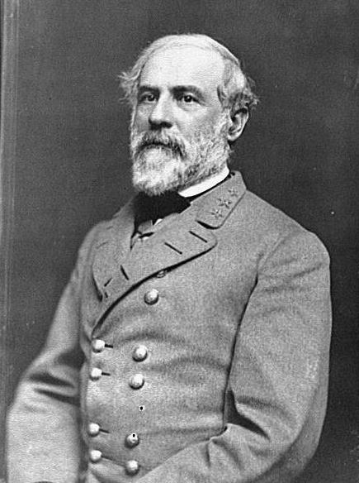
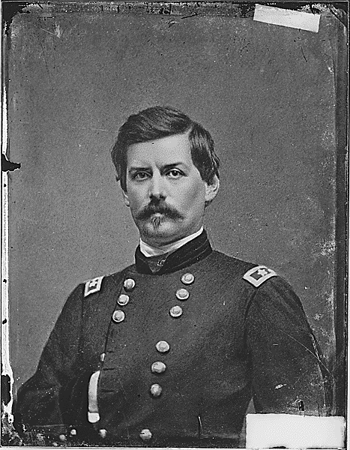
East in 1861-62 continued
Robert E. Lee
George B. McClellan

Slide 19
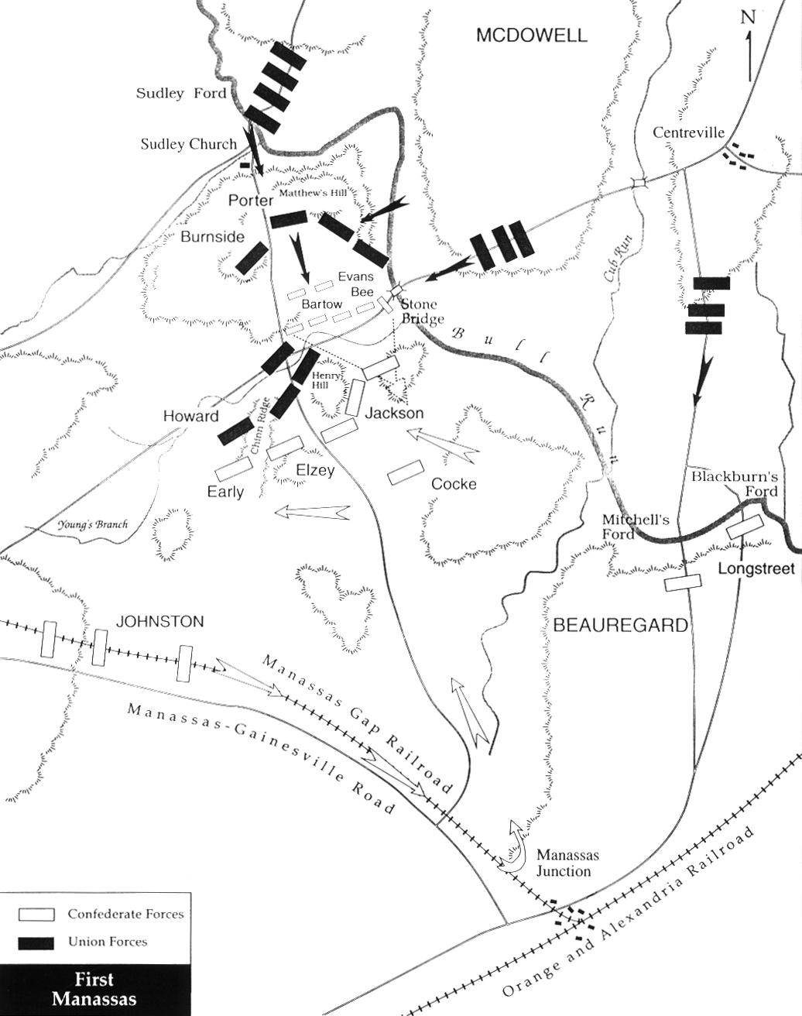
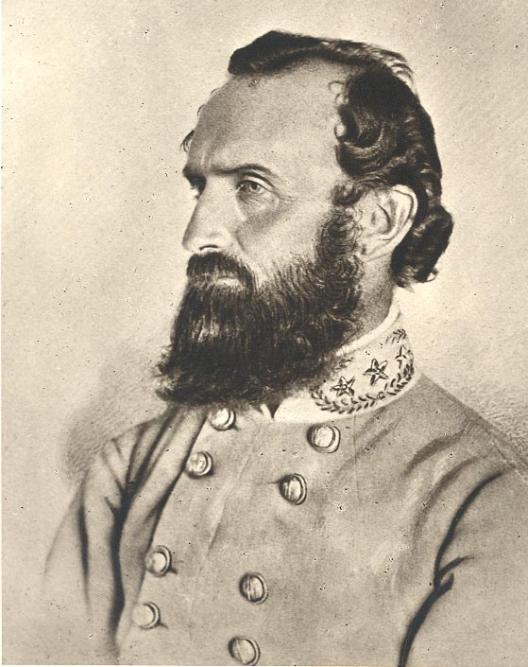
Stonewall Jackson

Slide 20
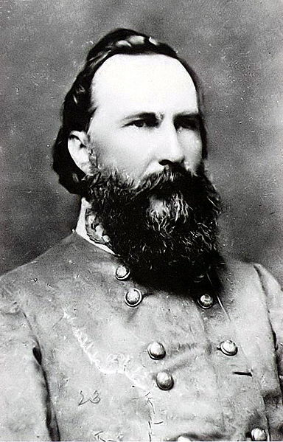
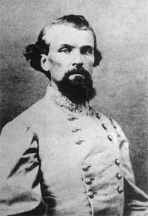
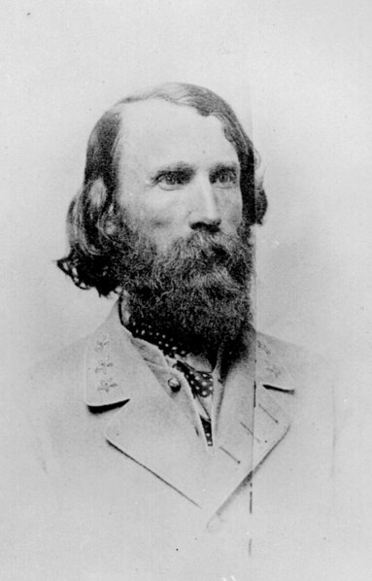
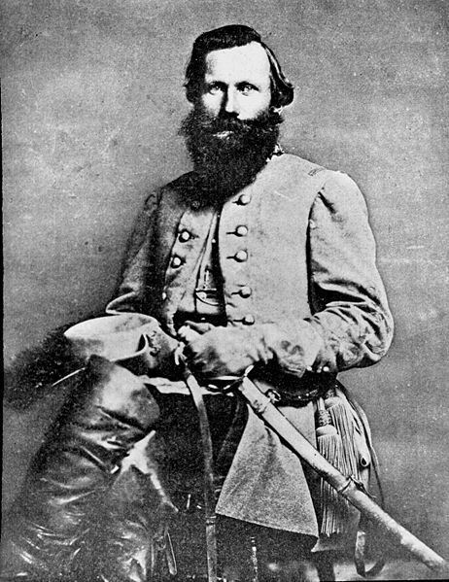
Confederate generals

Slide 21
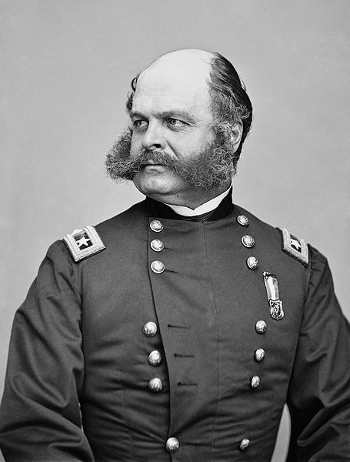
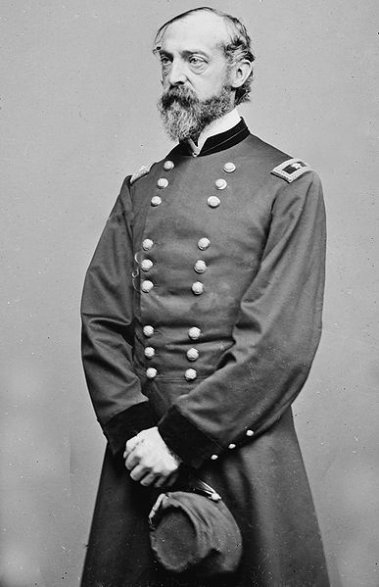
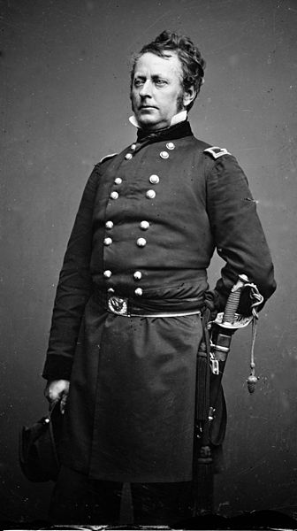
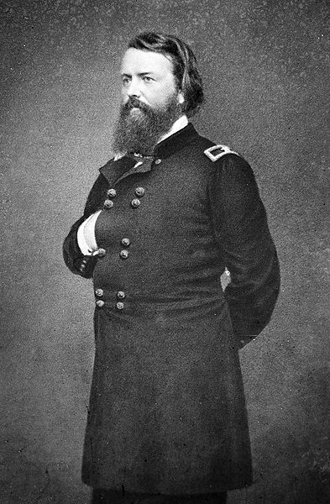
Union generals

Slide 22
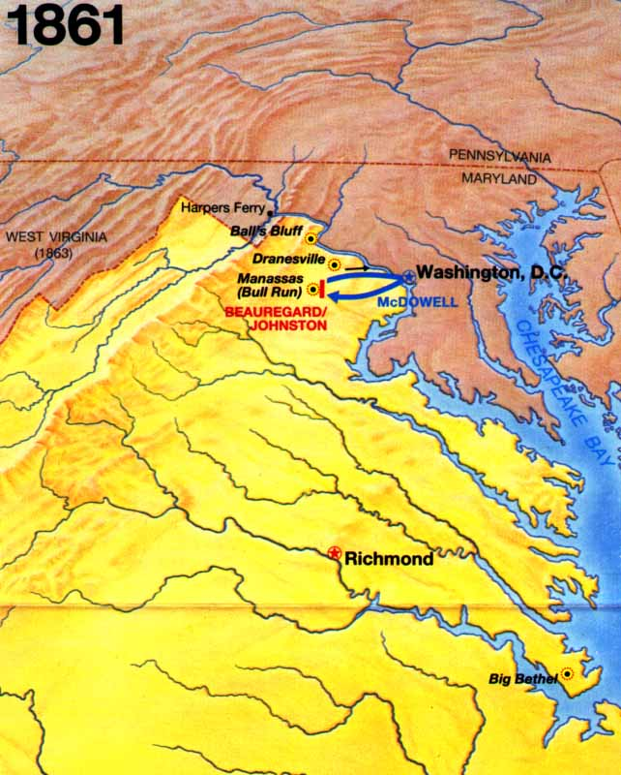
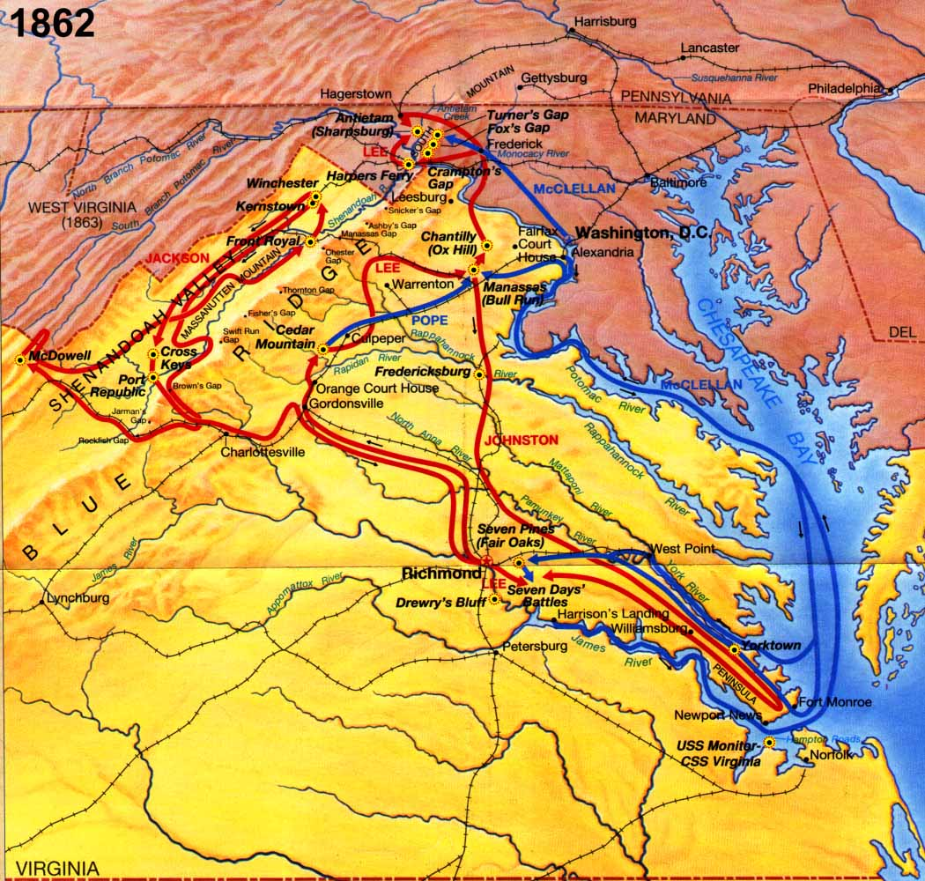
Eastern Maps for 1861-1862

Slide 23
Antietam(Sharpsburg) – September 17, 1862
Key battle of the war – South hoped that beating North in Maryland would bring in England and France on their side.
Lost Orders – McClellan finds a copy of Lee’s battle plan
Bloodiest single day of the war
Casualties – Union – 12,000
Confederacy – 13,000
Basically a draw, but long-term is a Union Victory

Slide 24
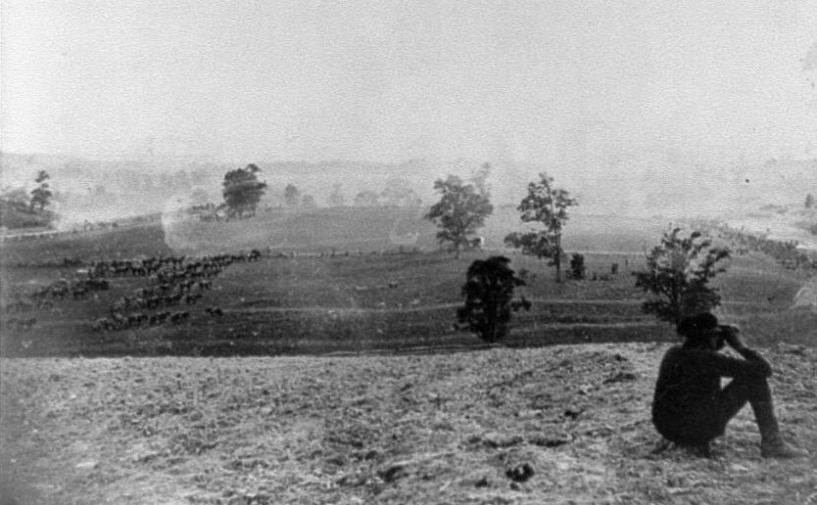
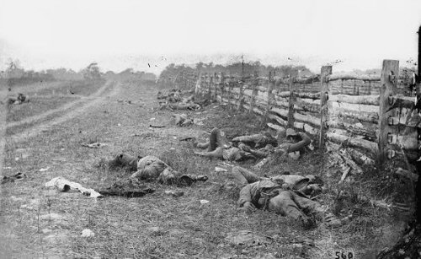
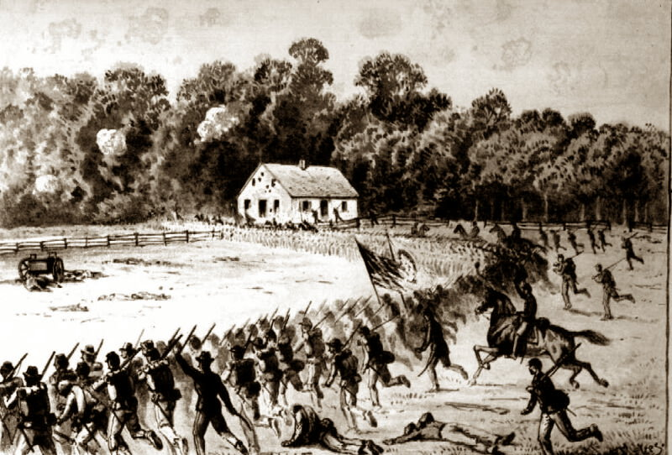
Battlefield View
Confederate dead

Slide 25
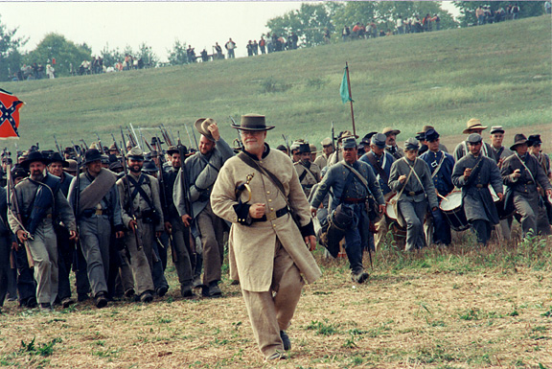
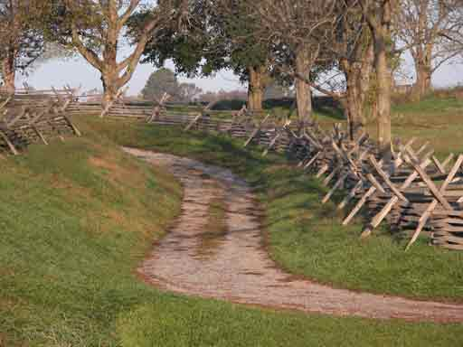
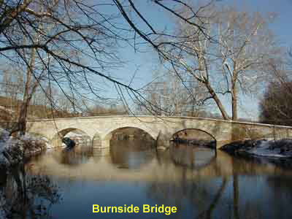
Bloody Lane

Slide 26
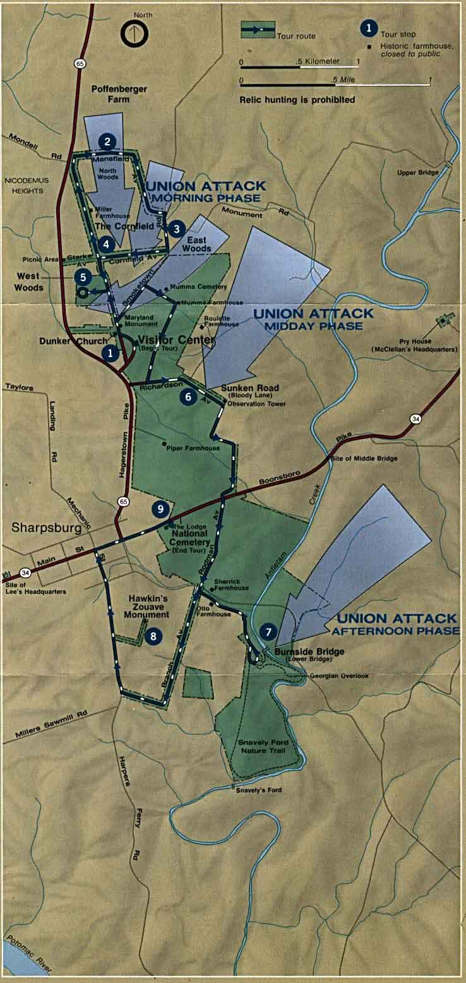

Slide 27
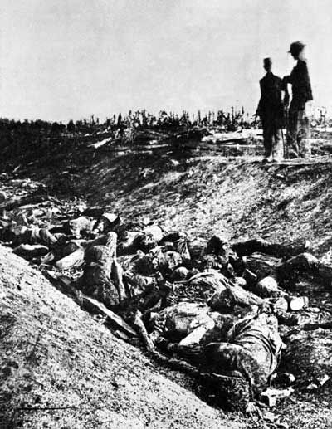
Bloody Lane

Slide 28
Union Blockade
North had many more ships and cut off Southern ports, stopping supplies from Europe
Blockade runners
Ironclads
First successful sub attack - Hunley
March 9, 1862 – Monitor vs. Virginia (Merrimac)
Last Confederate port open – Wilmington, NC – protected by Fort Fisher – captured by North on January 15, 1865

Slide 29
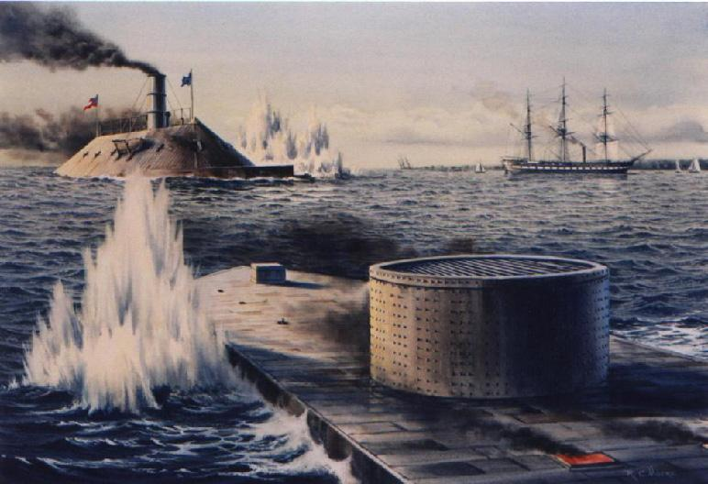

Slide 30
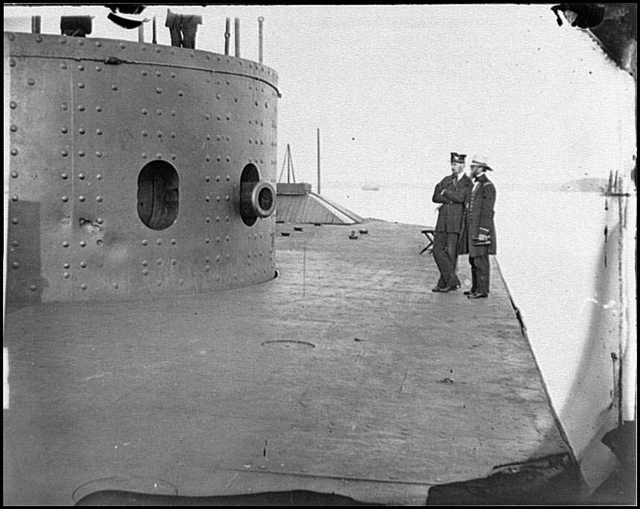
Monitor after battle with Virginia

Slide 31
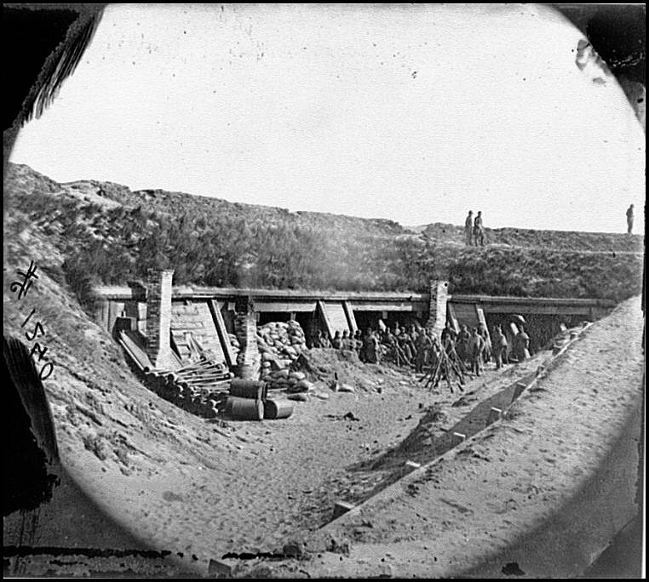

Slide 32
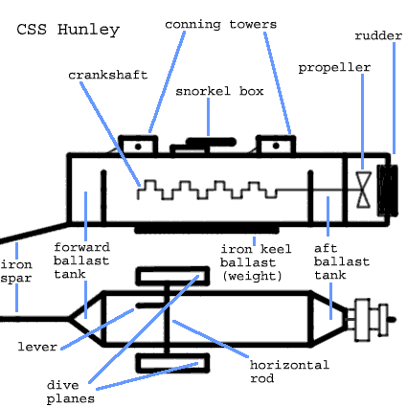
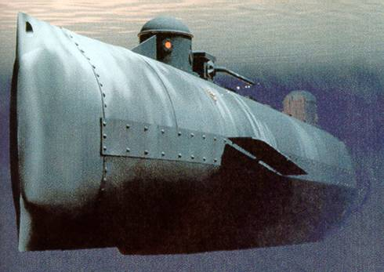

Slide 33
Vicksburg
Key battle in the West
May 22, 1863 – July 4, 1863
Union Commander – Ulysses Grant, assisted by William T. Sherman
Confederate Commander – John C. Pemberton
Union Victory – South is split in half

Slide 34
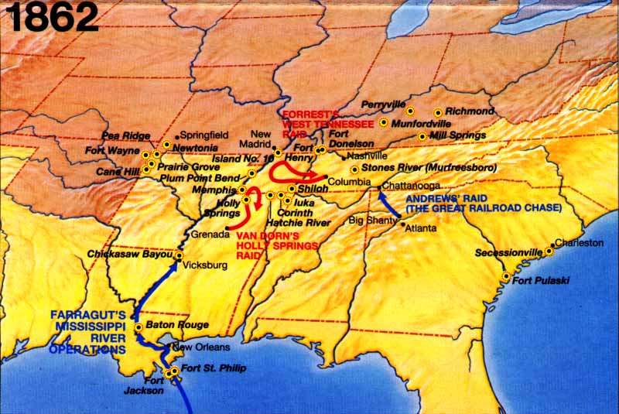

Slide 35
Emancipation Proclamation
Lincoln felt that freeing slaves in Confederacy would give the North moral superiority
Many northerners did not support this – They wanted to restore the Union, not end slavery
Was it constitutional?
What would the border states do? (KY, MO, DE, MD)
Had to wait for a Union Victory to issue it – Antietam
September 22, 1862 – would take effect on January 1, 1863
Caused many slaves to attempt to escape whenever Union troops were nearby

Slide 36
Black Soldiers
Large casualties led some northerners to look at black men as a new manpower source
1863 – blacks could join the army to fight
54th Massachusetts Regiment – Fort Wagner – July 18, 1863 – (Glory)
180,000 blacks served with the Union army

Slide 37
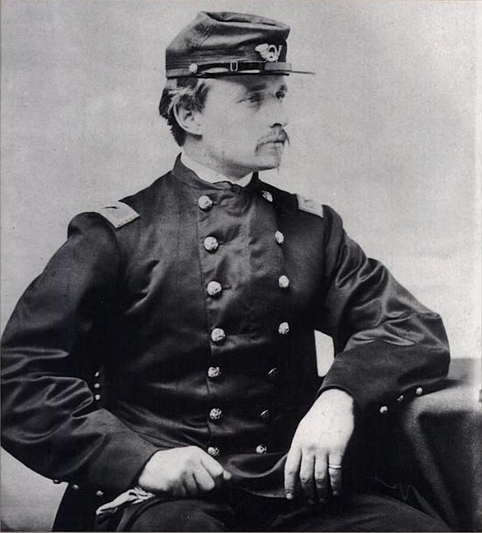
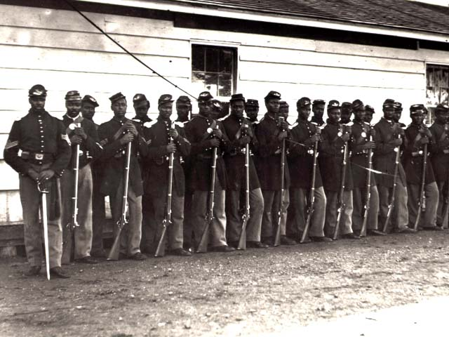
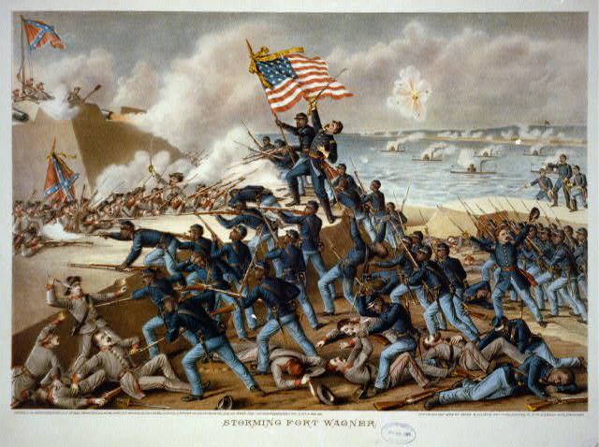
Robert Gould Shaw
54th Massachusetts soldiers
Attack on Fort Wagner

Slide 38
War Opposition
Emancipation upset many Northerners
Copperheads – anti-war Democrats
Lincoln dealt with opposition by suspending “Habeas Corpus” – constitutional protection from unlawful imprisonment
1863 – passed a military draft – caused riots in several cities – New York
“Rich man’s war, poor man’s fight”
South – Prices shot up as blockade cut off supplies – not enough of anything
Confederate money was worthless
Food riots
Draft law of 1862 – large slaveowners were exempt
States did not cooperate – each looked out for its own interests first

Slide 39
Home Front
Many men off at war – women had to fill in the jobs – factories, farms etc.
Women had important roles as nurses – Dorothea Dix, Clara Barton, Sally Tompkins
Dr. Mary Walker—surgeon, spy for the Union, won Congressional Medal of Honor & Sarah Emma Edmonds who fought as a man
Army camp life was hard
Prison camps were extremely bad – Andersonville
Twice as many soldiers die of disease than in combat
Medical care is poor – didn’t know how to treat infections

Slide 40
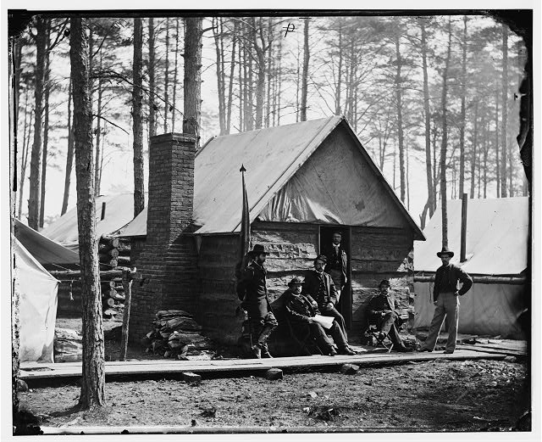
Union Camp

Slide 41
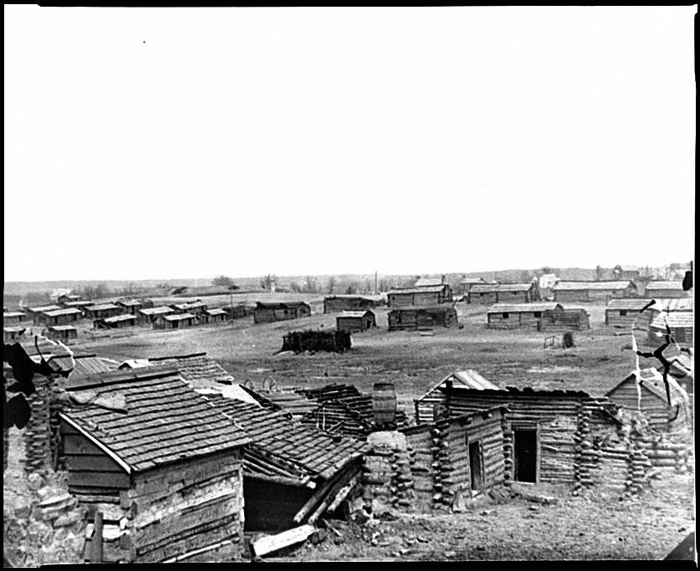
Confederate Camp

Slide 42
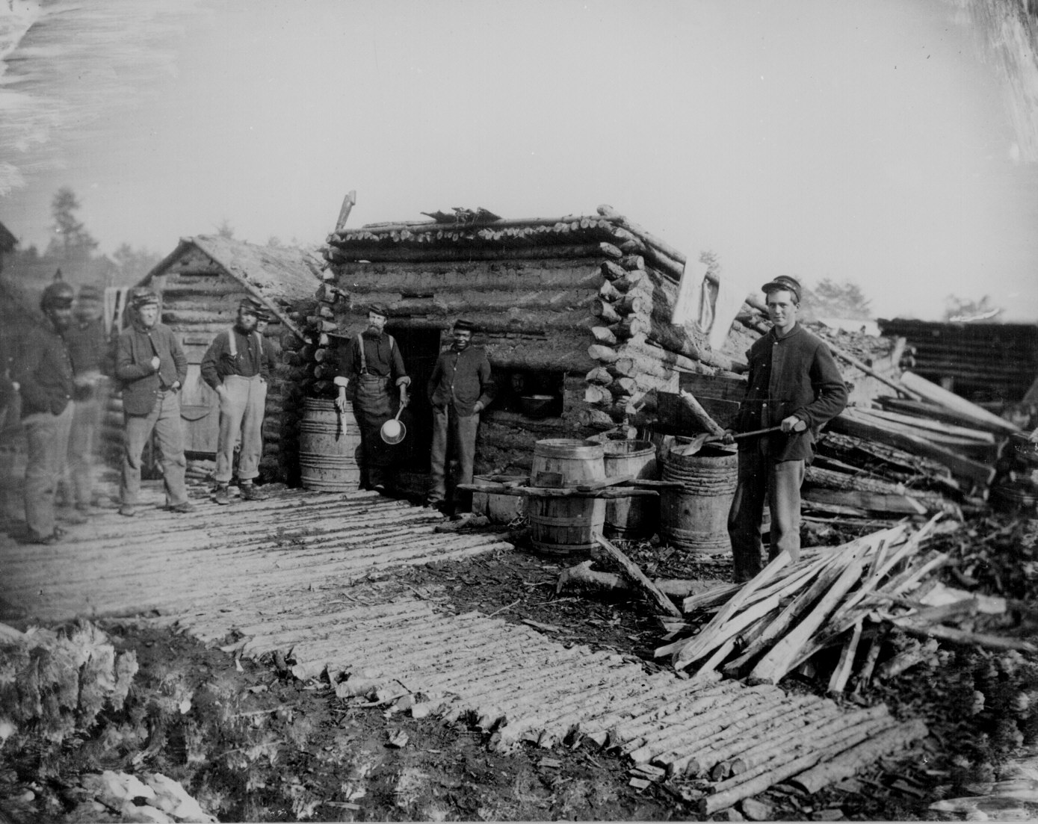

Slide 43
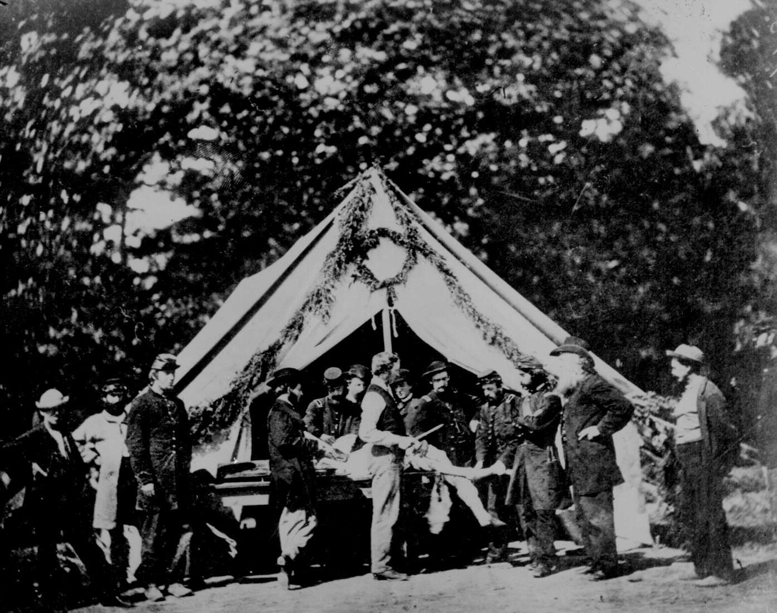
Union Doctor Performing An Amputation

Slide 44
Civil War amputations

Slide 45
Gangrene

Slide 46
Union Prisoners Getting Food at Andersonville

Slide 47
Union Army Cooks Preparing Dinner

Slide 48
Gettysburg
July 1-3, 1863 – Lee hoped that winning a battle in the North would cause the Union to give up and gain the South European assistance
Day One – Culp’s Hill, Cemetery Hill
Day Two – Little Round Top
Day Three – Pickett’s Charge
Casualties
Union – 23,000
Confederate – 28,000
South Is on the defensive for the rest of the war
Gettysburg Address – Nov. 19, 1863
Jennie Wade – only civilian killed
NC loses more men at Gettysburg and throughout the war than any other state
26th North Carolina Regiment – loses 714 of 800 men

Slide 49
Day One
Day Two
Day Three

Slide 50
Little Round Top

Slide 51
Dead Union Soldiers in the Wheatfield

Slide 52
Dead Union Soldiers in front of Cemetery Ridge

Slide 53
Devil’s Den

Slide 54
End of the War
Grant takes over Union Army
Total War – Grant and Sherman
Sherman’s March to the Sea – Spring 1864 to December 1864
Wilderness Campaign – May – June 1864 – some of the bloodiest battles of the war
Petersburg – June 1864 to March 1865
Lee attempts to retreat and join other Confederates in NC, but is caught and surrounded by Grant
Appomattox Court House – April 9, 1865 – Lee surrenders his army
April 14, 1865 – Lincoln is assassinated by John Wilkes Booth – southern sympathizer
Remaining Confederate forces surrender by end of May 1865
War Deaths
Union – 360,000 – 110,000 in battle
Confederacy – 258,000 – 93,000 in battle
Total – 620,000 – revised to 750,000 recently
NC – about 21,000 – 3 times that of any other southern state

Slide 55
Siege of Petersburg
Wilderness Campaign

Slide 56
Lincoln/Kennedy assassination
Abraham Lincoln was elected to Congress in 1846. John F. Kennedy was elected to Congress in 1946. Abraham Lincoln was elected President in 1860. John F. Kennedy was elected President in 1960.
The names Lincoln and Kennedy each contain seven letters. Both were particularly concerned with civil rights. Both wives lost their children while living in the White House. Both Presidents were shot on a Friday. Both were shot in the head.
Here is an interesting one...
Lincoln's secretary was named Kennedy. Kennedy's secretary was named Lincoln.
Both were assassinated by Southerners. Both were succeeded by Southerners.
Both successors were named Johnson. Andrew Johnson, who succeeded Lincoln, was born in 1808. Lyndon Johnson, who succeeded Kennedy, was born in 1908. John Wilkes Booth, who assassinated Lincoln was born in 1839. Lee Harvey Oswald, who assassinated Kennedy was born in 1939. Both assassins were known by their three names. Both names compromise fifteen letters. Booth ran from the theater and was caught in a warehouse. Oswald ran from a warehouse and was caught in a theater.

